Slide 1
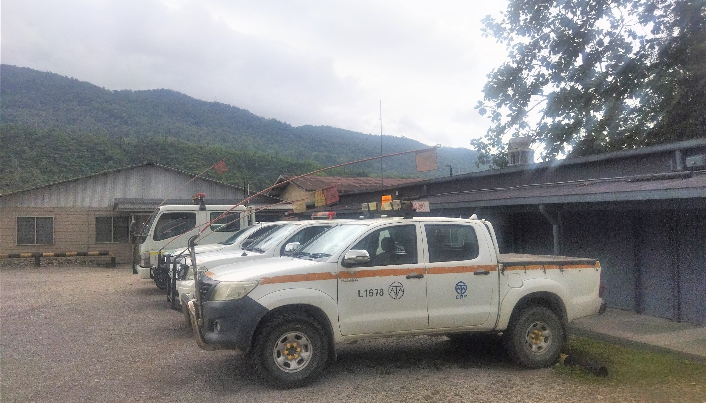

Light Vehicle Park Up
Awareness Package

Slide 2
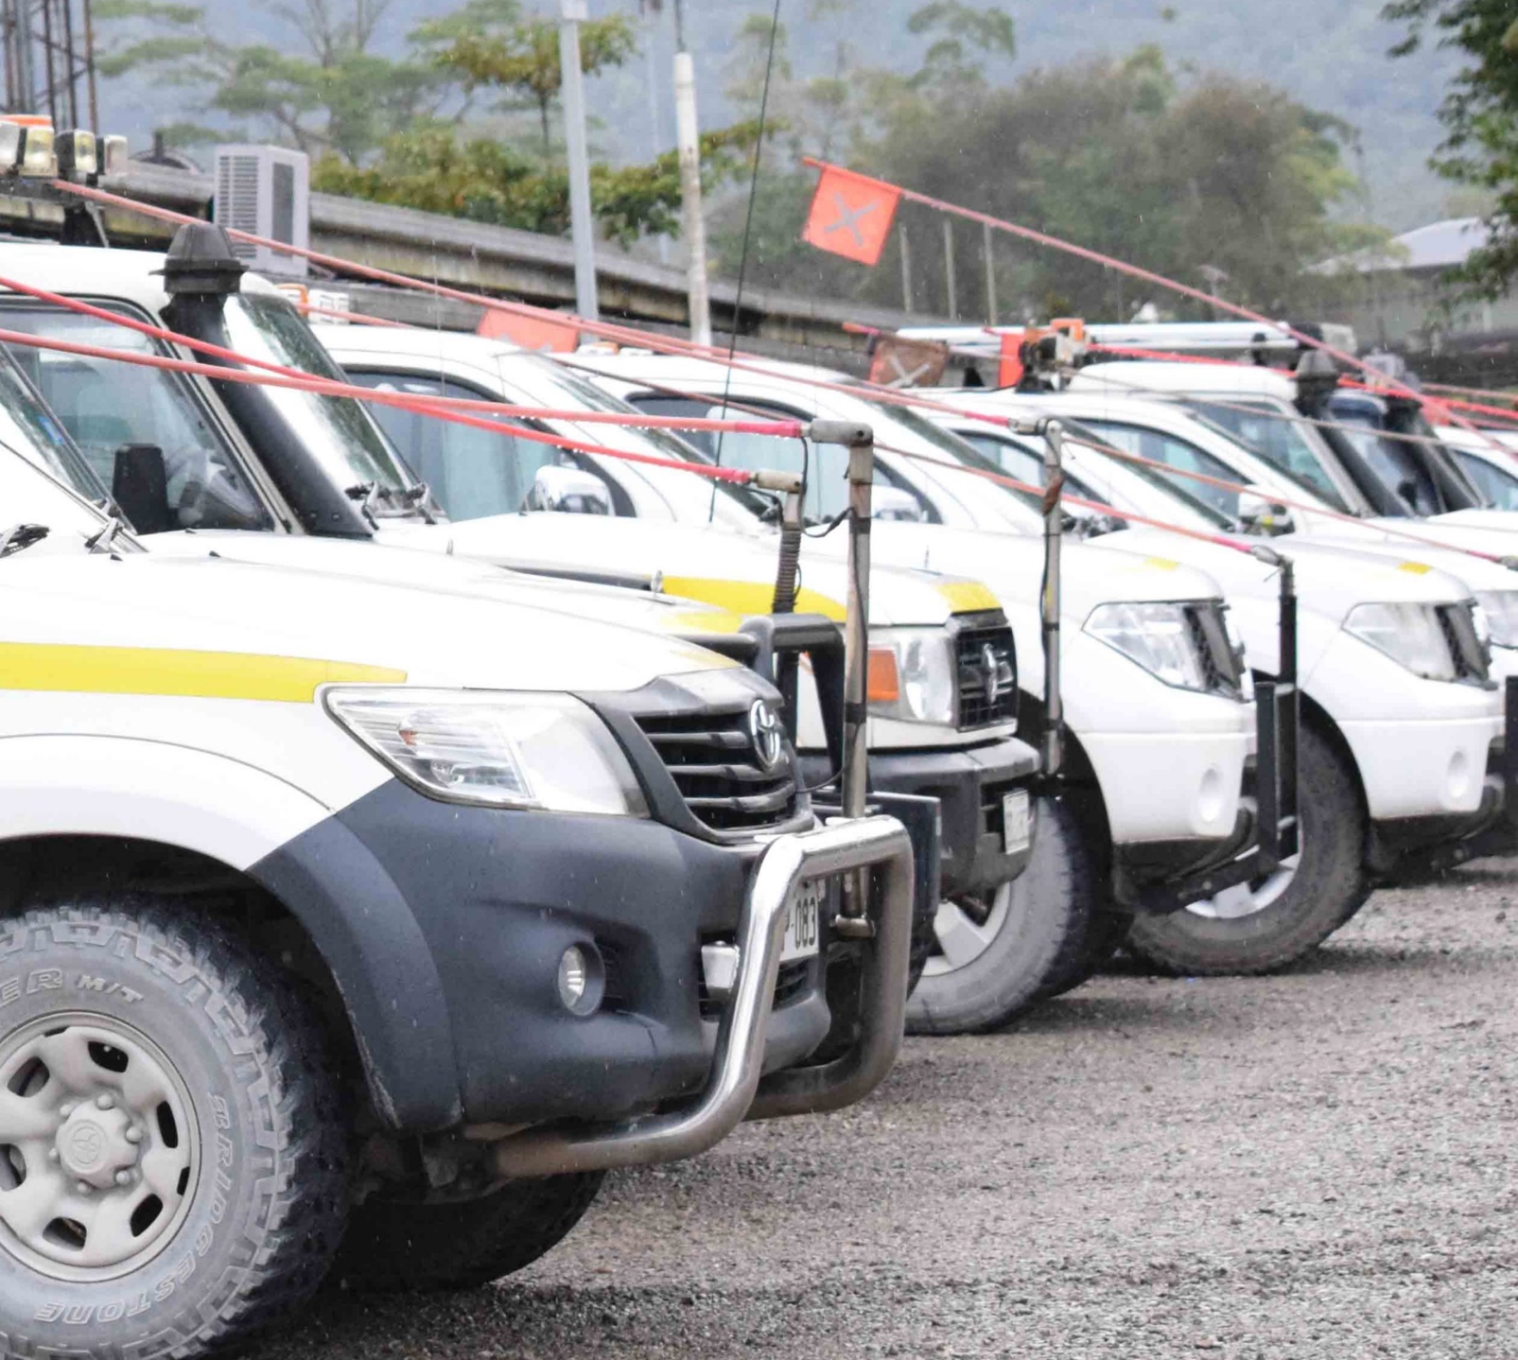
Purpose of this Awareness Package
To raise awareness for all OTML and Contractors of the Site Standard requirements associated when Parking to ensure that light vehicles are parked and left in a safe manner (fundamental stability) when the operator & passengers leave the vehicle.
If Vehicles & mobile equipment are not parked correctly, they may roll (uncontrolled movement) and cause damage to:
  People
  The vehicle
  Other vehicles within the area
  Fixed Plant or Structures

Slide 3
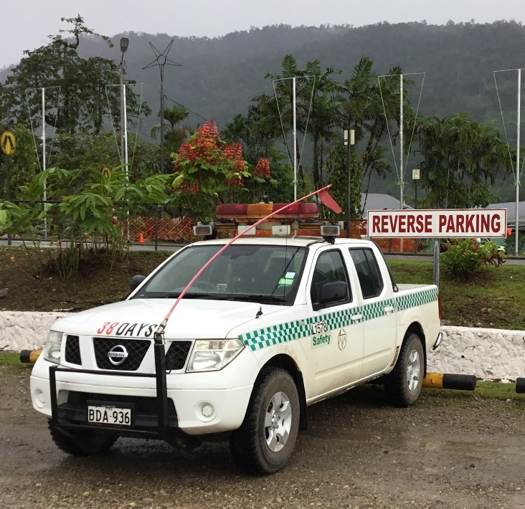
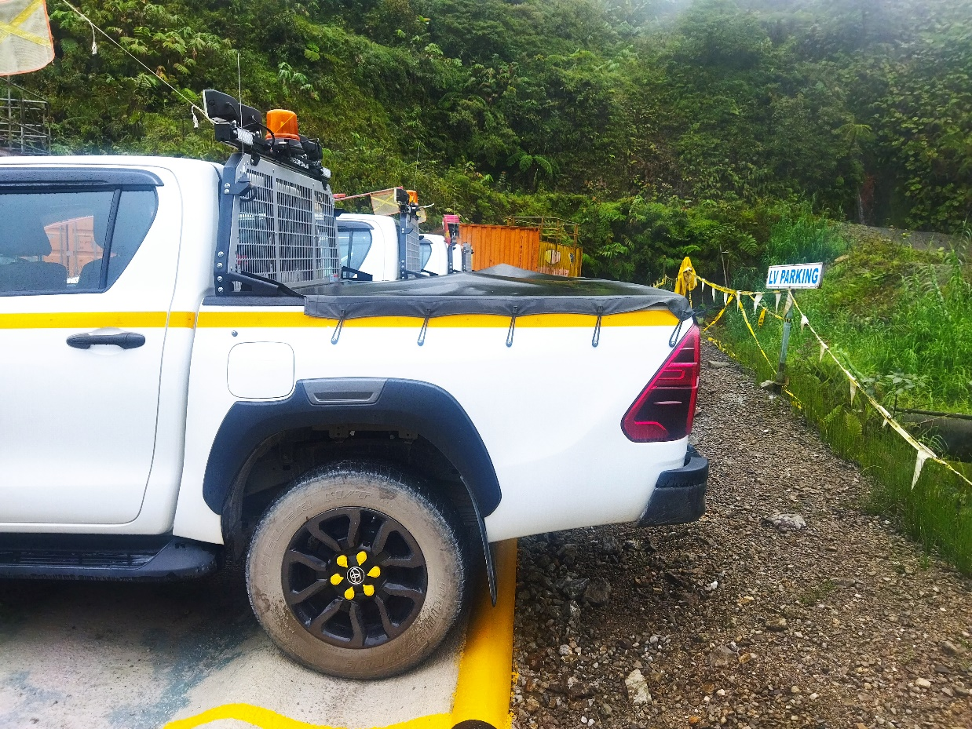
Where to Park – Designated Car Parks
Where available, park in a designated parking area.
Obey all signage.
Unless sign posted / indicated OTML carparks are reverse parking, be aware and park accordingly.
Park with wheels against the bump rails or in the V drain or behind the humps to assist in preventing uncontrolled movement.
Maximum speed in a car park is 10kph or as per speed signage of the parking area.
Look out for pedestrians and other vehicles or mobile equipment.

Slide 4
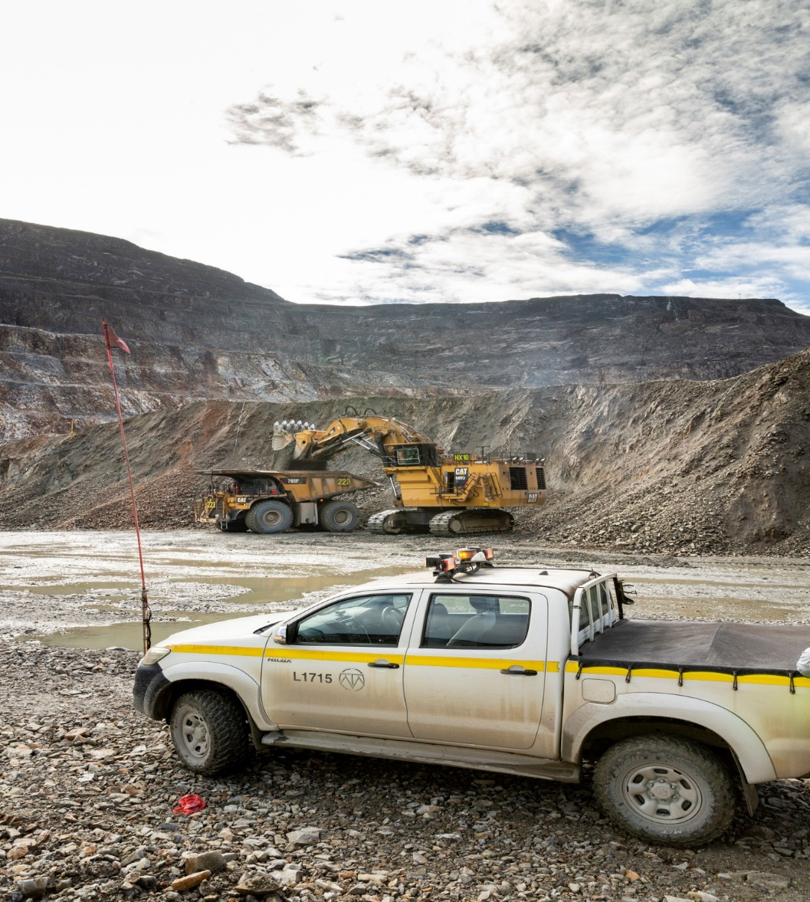
Where to Park – When no Car Park is Available
Park in a location:
  Where it is Safe to do so
  Where you are not in the potential path of other vehicles.
  Where the parked vehicle can be seen by other vehicles.
  Where the driver and passengers can safely get out of the vehicle.
  Preferably on level/flat and stable ground.
  Chock wheels if necessary
  Park so that the vehicle can travel forward when leaving
  Never leave a running vehicle unattended
When in operational areas, vehicle & mobile equipment operators must know and comply with the parking rules of that area.

Slide 5
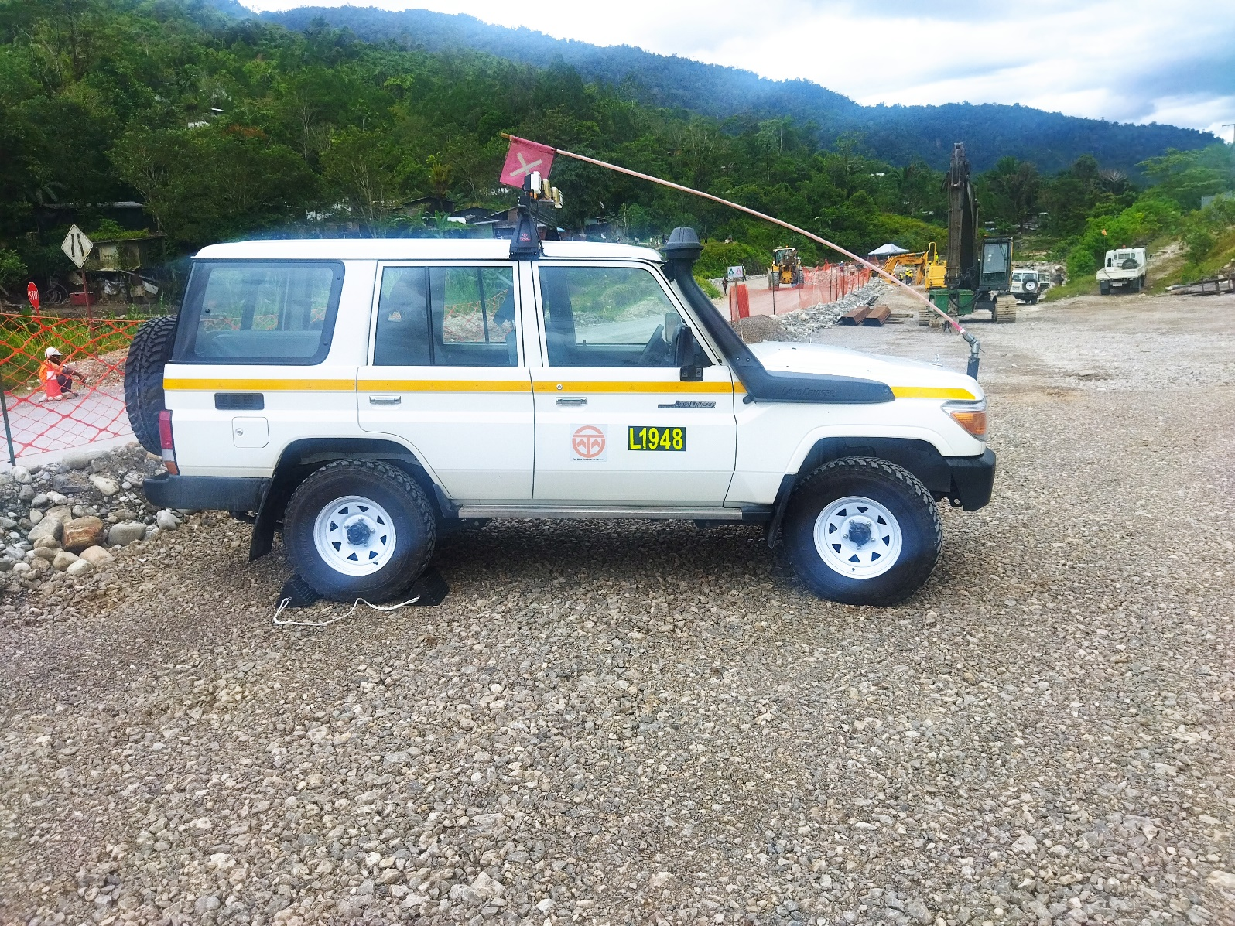
Parking In Unusual Circumstances
Breakdowns:
  Try to get the vehicle off the road to a location where it is clear from the traffic flow and visible to other vehicles.
  If required, turn on hazard lights and provide signage to other road users.
If it is necessary to park on a hill or slope:
  If possible, park across the slope instead of facing uphill or downhill.
  Turn the wheels to steer the vehicle away from the downhill direction and away from potential traffic.
  Chock the wheels.
  Personnel to stand on the upside of the vehicle

Slide 6
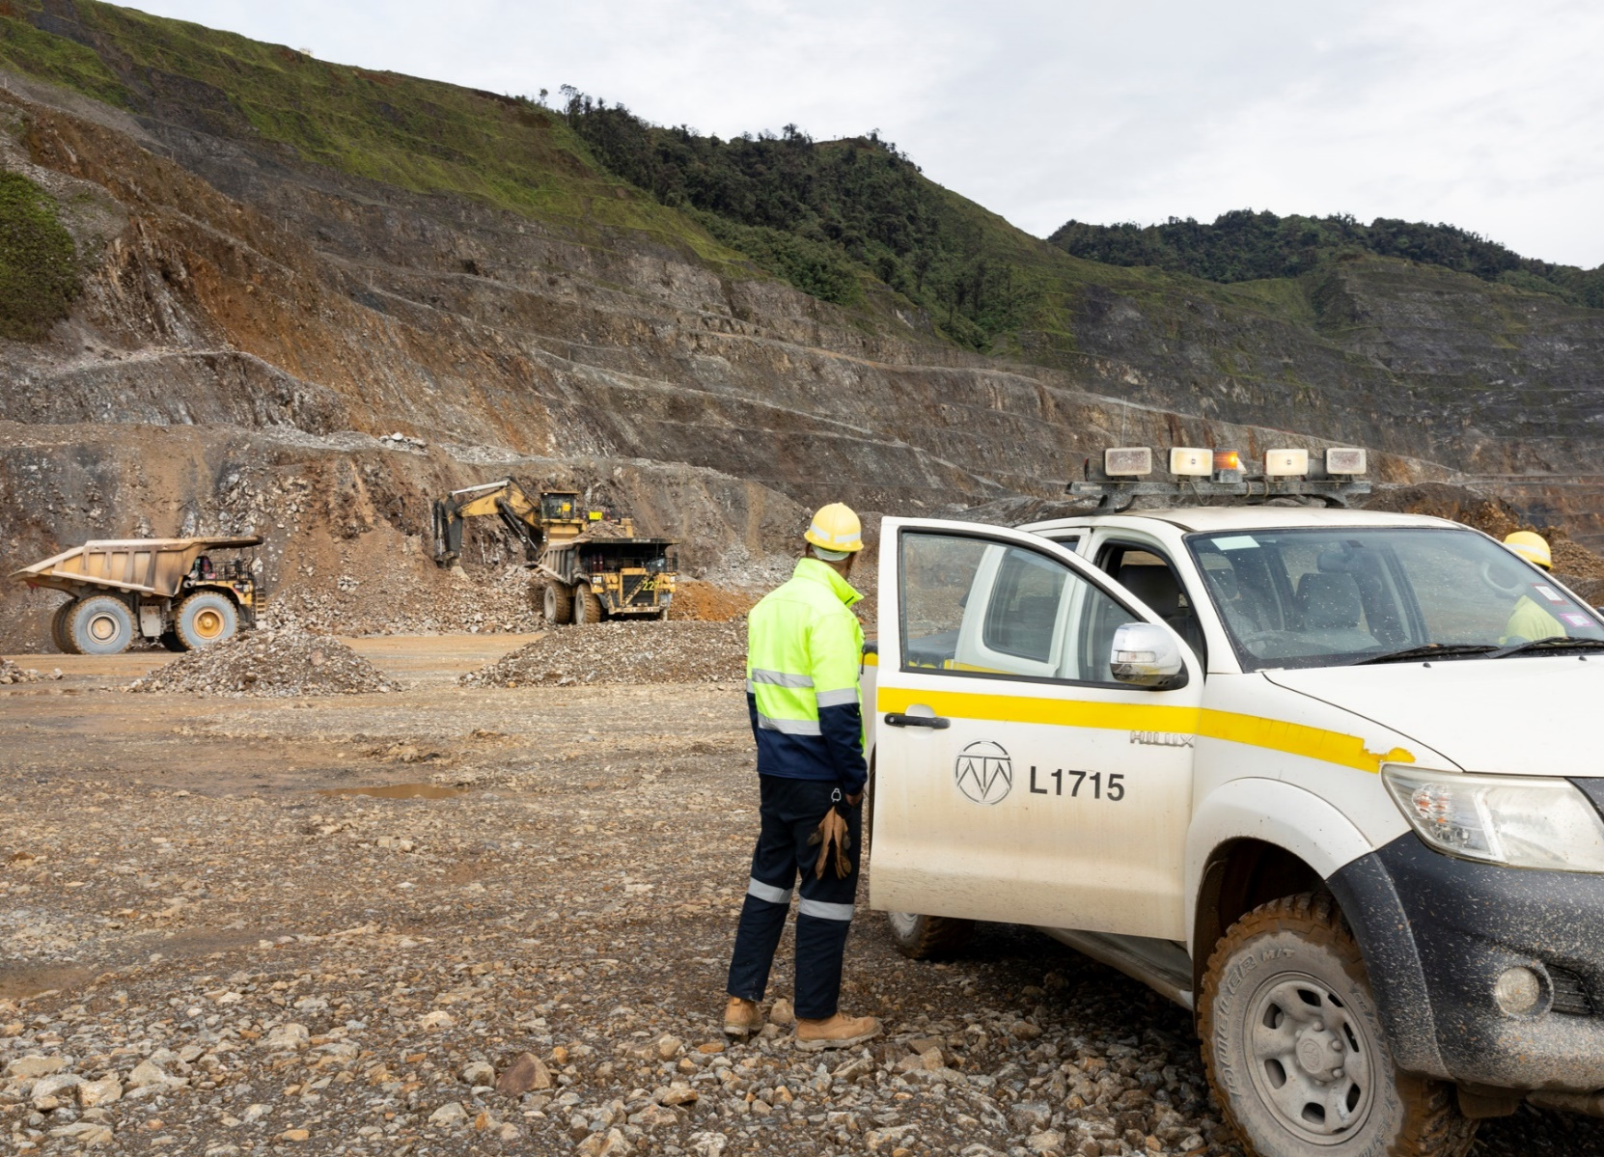
Leaving the Vehicle
Apply the handbrake.
Place the vehicle in a gear contrary to the direction of movement i.e.. 1st gear or reverse.
Turn off the ignition and remove the key. Do not leave the motor running, even if you are only getting out briefly.
In the case of mobile equipment, place any implements on the ground.
If parking on a slope:
  Turn the wheels away from the downhill or toward a berm.
  Chock the wheels.

Slide 7

Questions

